Slide 1
Can’t sleep at night? You must be a CISO!
Nashville Security and Technology Conference - 2014
Jack Key
ISE® Industry Expert
Notes:
Abstract: with so many demands and challenges facing today’s CISO, what should a CISO be focusing on? Without a crystal ball, looking into the future is somewhat of a guessing game. However, there are some fundamental tried and true practices that work today that will also work in the future. This presentation will focus on three key fundamentals; people, processes and technology. What does a future cyber security professional look like and where are they coming from. Today’s processes have to expand beyond a traditional internal focus and look at expanding relationships and dealing with a larger 3rd party utilization strategy. What are the limits of our current technology and do we need to become innovators in order to address current and future technology gaps.

Slide 2
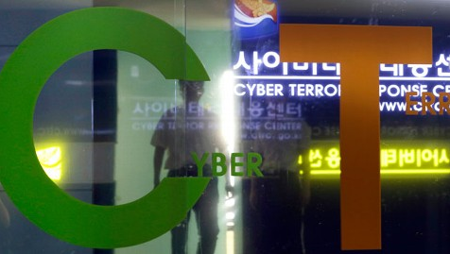
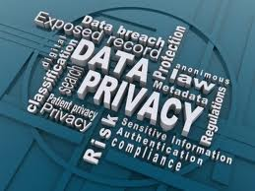
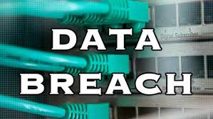
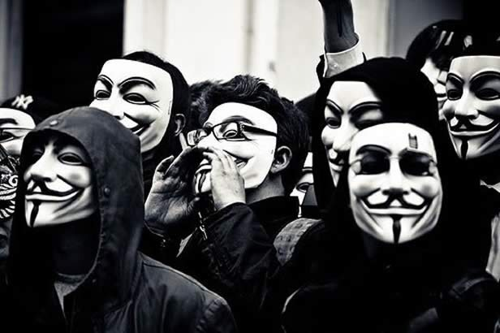
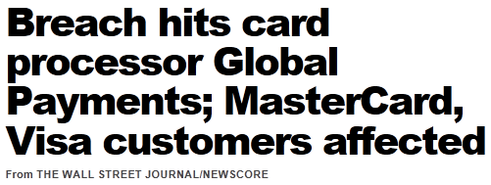
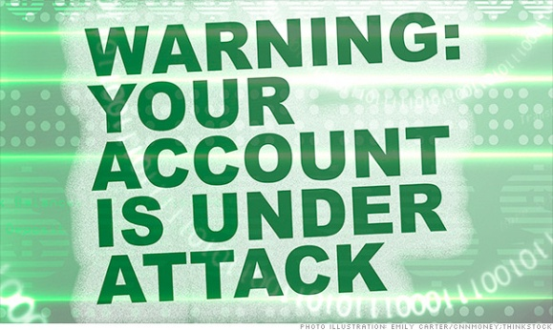
The New Normal
TARGET
Notes:
Cyber security is a strategic issue
More visibility in the media
Highest levels of attention in our government
Growing consumer expectations and unhappiness
The risk is increasing for consumers, companies, agencies, governments
EY divides cyber attackers into three buckets, aid Terry Jost, principal in the EY cybersecurity practice.
1 Nation states looking to steal intellectual property (IP). Threats are already a huge number and the attacks are escalating.
2 Organized crime, sometimes with backing by some other entity, looking to steal money.
3 Hacktivist aiming to disrupt an organization often on behalf of some cause.

Slide 3
So you want to be a CISO….
“Chief information security officers have one of the toughest jobs in the business world: They must stay one step ahead of criminal masterminds in Moscow and military hackers in Shanghai, check off a growing list of compliance boxes and keep close tabs on leaky vendors and reckless employees who upload sensitive data to Dropbox accounts and unlocked iPhones.”
New York Times

Slide 4
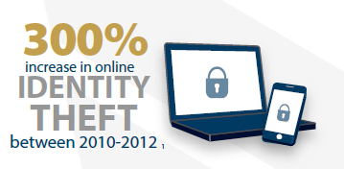
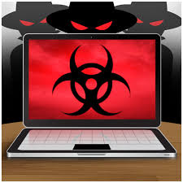
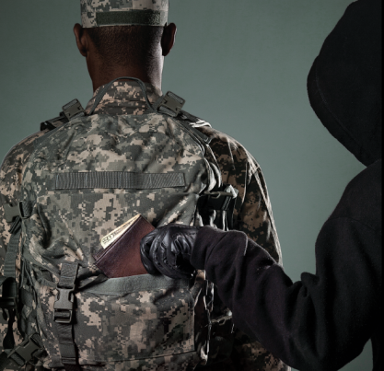
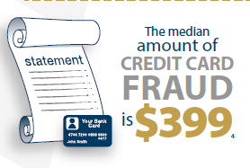
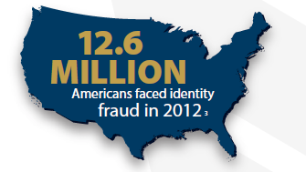
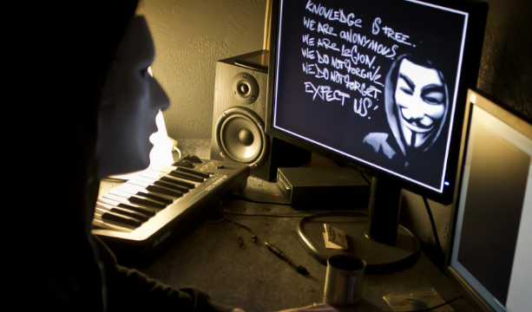
The Changing Threat Landscape - The Facts
Top countries where cyber attacks originate: Russia, Taiwan, Germany, Ukraine, Hungary, USA, Romania, Brazil, Italy Australia, and Argentina.
$87 Million unique strains of malware released each year by 2015
$21 billion amount fraudsters took from identity theft victims, the highest amount since 2009
Number of foreclosure relief and debt management scam and fraud complaints from military families
67,000
$200 Million Cost of Cybersecurity attacks to businesses in 2011
1 person is a victim of identity fraud every 3 seconds
facebook
More than 600,000 Facebook accounts compromised per day
Source: FTC.gov/sentinel
Identity fraud incidents increased by more than $1Min 2012
92% of breaches perpetrated by outsiders
Notes:
Key Data Points:
62% increase in number of breaches logged
Targeted attacks grew by 91% and lasted three times longer
552 million personal identities exposed
(source: SC Magazine - Internet Security Threat Report 2014 – Symantec”, DCB 4/18/14)
The 2013 Identity Fraud Report released in February 2013 by Javelin Strategy & Research reports that in 2012 identity fraud incidents increased by more than one million victims and fraudsters stole more than $21 billion, the highest amount since 2009
By the end of 2015, the Aite Group (a Boston-based analytics firm) estimates that there will be 87 million new, unique strains of malware released each year
Sources: 1=Experian, 2012, 2=shop.org, 3=Javelin Strategy and Research 2012, 4=US department of Justice, July 2012

Slide 5
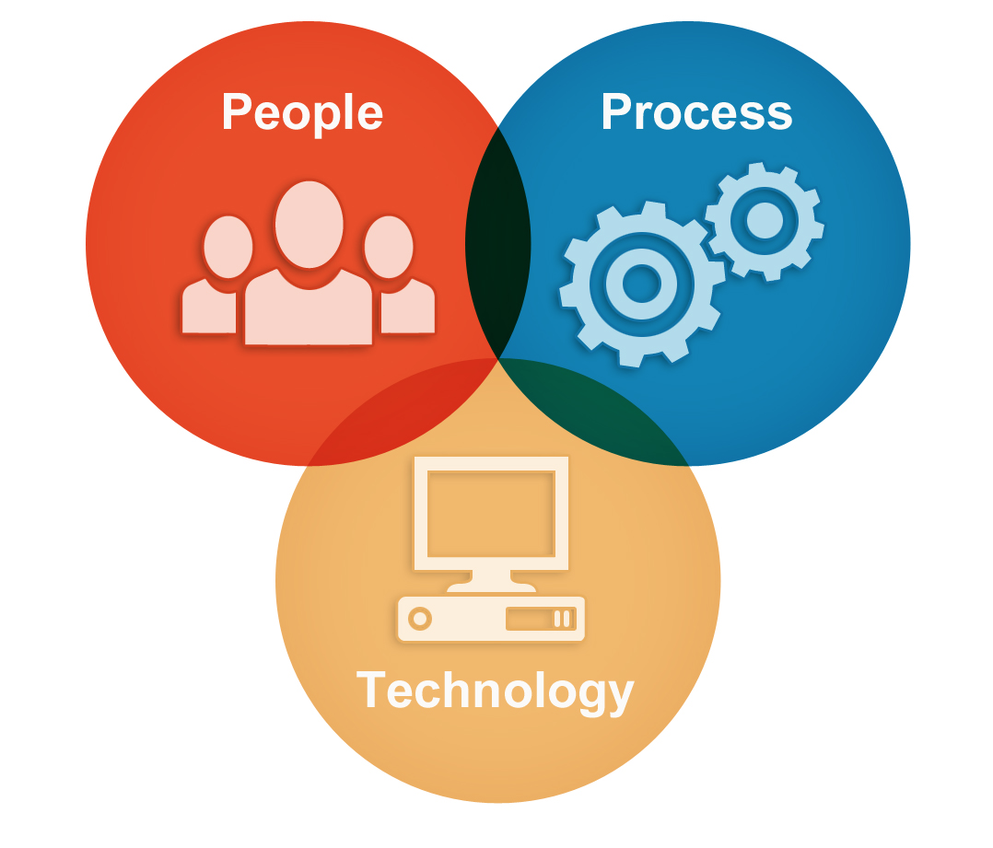
PEOPLE

Slide 6
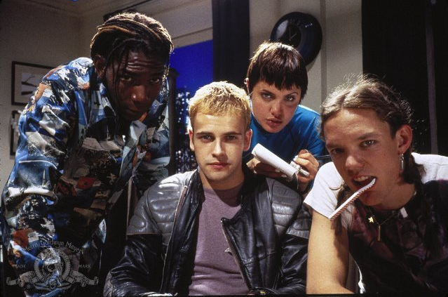
Develop skilled cyber security professionals
PEOPLE
HACKERS – 1995 © Metro-Goldwyn-Mayer Studios Inc. All Rights Reserved.

Slide 7
Building a foundation for the future
PEOPLE
◆ Colleges adding cyber curriculum
◆ Curriculum addresses both technical and theoretical issues
Designated by the NSA and DHS as a center of academic excellence
◆ Undergraduate and graduate courses in the areas of digital forensics, secure network design, intrusion detection and incident response
2014 Best Schools for Cyber Security
University of Texas, San Antonio
Norwich University
Mississippi State University
Syracuse University
Carnegie Mellon University
Purdue University
University of Southern California
University of Pittsburgh
George Mason University
West Chester University of Pennsylvania
U.S. Military Academy, West Point
University of Washington
Ponemon Institute

Slide 8
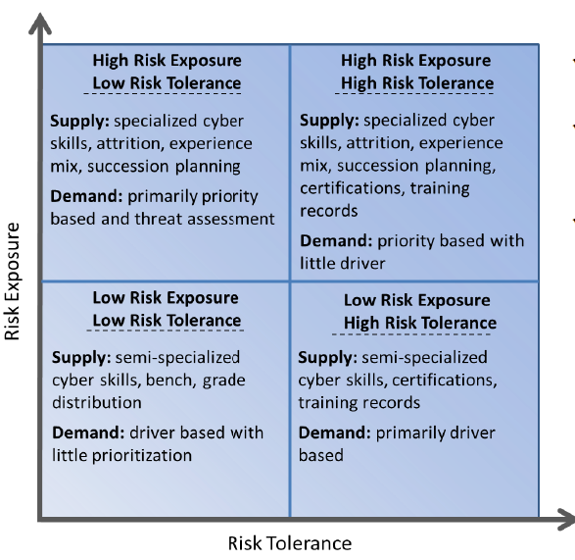
Develop skilled cyber security professionals
PEOPLE
◆ Specialized skill sets
◆ Advanced Training
◆ Cross domain experience
◆ Certifications, Conferences – you have to invest in your employees

Slide 9
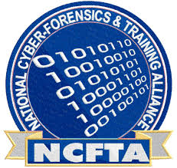
Building Strong Relationships is Key
PEOPLE
Enable your strategy by enhancing public and private relationships
◆ Industry Peers
◆ Government
◆ Law Enforcement
◆ Commercial & Open Source
◆ Academia
◆ Personal
Notes:
***INFOSEC***
Cyber Intelligence -- Building Strong Relationships across Industry, Government and Law Enforcement
As we continue to evolve our security capabilities, forming relationships with government, law enforcement, military, and industry leaders is extremely important for reinforcing our brand as well as maximizing information sharing opportunities.
We routinely have the USSS and FBI at our cyber briefings
We are actively engaged in the FS-ISAC in sharing Cyber Intel and partnering with key industry peers
We have several Cooperative Research and Development Agreement to share information with government agencies
We partner with Local AF, Army, and Navy organizations to share best practices
Personal relationship have paid big dividends especially during the initial DDOS activities.

Slide 10
PROCESS

Slide 11
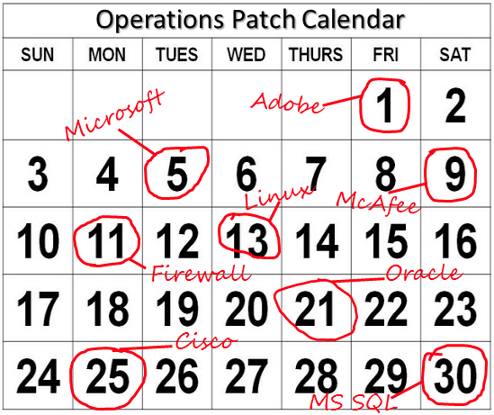
PROCESSES You need strong processes to be successful
◆ Extensive Log Aggregation, Correlation and Analysis
The goal of a risk assessment:
Ensure that necessary security controls are integrated into the design and implementation of a project or technology.
Provide documentation outlining any security gaps between a project design, technology and approved corporate security policies.
Address security gaps in three ways: Cancel the project, allocate the necessary resources to correct the security gaps, or accept the risk based on an informed risk / reward analysis.
Who is the senior leader that would suffer harm if the data is lost?
Individual leaders must be actively engaged in the protection of their own mission critical data.
Engagement will vary dependent upon how critical the Information Security function is – and that is not necessarily bad.
Formal Risk Management and War Games can help.
Identity and Access Management, business underpinned by:
- right employees
- right access
- right members data
- right time
right applications
Start with a definition:
An elevated privilege is the usage of system administrator privileges for information systems identified as high-risk by the Information Security information system risk rating process.
◆ Strong Identity and Access Management, Minimize elevated privileges
FS-ISAC
Fraud
SIEM
Internal Systems
Threat Intelligence Committee
Physical Security
Cyber Information Sharing Collaboration Program
Mark Monitor
BITS
Open Source
Government Agencies
Intelligence
◆ Strong Patch Management
◆ Business Enabling
Operational Process
Analytics
◆ Risk Assessments

Slide 12
Metrics
PROCESSES

Slide 13
Metrics – An Example, Security Risk Index
Security Risk Index
PROCESSES
Definition / Calculation
Measures company’s risk associated with a specific number of distinct information security threats that impact members/consumers and/or the enterprise to a significant degree index factors Vulnerability management Security events triage Fraud event Data incidents Phishing sites Malware infections Phishing Supply chain data
Final value is a % change from base value. Monthly Index is a three month normalized value.
Significance
Identification of emerging Information Security Risks. If breached, multiple business units and/or overall network(s) would be impacted.

Slide 14
Metrics – An Example, Security Risk Index
PROCESSES
Information Security Threats:
Member/Consumer |  |  | Enterprise |  |  | Supply Chain |  | Information Security Risk Index
Fraud Event per Unique User Fraudulent removal of funds from a members account | .24 |  | Vulnerability Management Avg. open per day The number of vulnerabilities that remain un-patched beyond the date they should have been addressed. | .27 |  | Supply Chain Risk assessment of the type and volume of company information being released into the supply chain. | .08
Data Incidents (% Mbrs) (Basis Points) Company or member data has left the building through the fault of a 3rd Party or company. | .10 |  | Security Events Triage Avg. handling time in days per month Time it takes for an analyst to review and assess a security event (from detection to resolution). | .20
Phishing Sites Avg. site open in hrs open per day The average number of hours per day that Phishing sites (attacking company) were up and running | .05 |  | Malware Infections Basis point calculation of number of machines which were infected | .06
Index value: | .39 |  |  | .53 |  |  | .08 | = 1.00
Notes:
Statistical Formula:
Normalization Formula = (x-y)/z+1
An example of this formula is most easily expressed in the case of account takeovers. In the weekly index, for week ending 03/26/2013, there were 153 total account takeovers. This value is divided by total unique users for the month of March, 4,846,917 to create a basis point value of .32. The mean for 2012 is .25 basis points and the standard deviation is .14. The normalized value is therefore .32 minus .25 divided by .14 plus 1, or 1.45.
A point of contention in any derived index is the weighting imposed on each of the variables. In the case of the security risk index the common qualifier was impact to the association if the value exceeds the mean. The normalized value is multiplied against the assigned weighting and the value derived is added together with the weighted value for the other 8 variables.

Slide 15
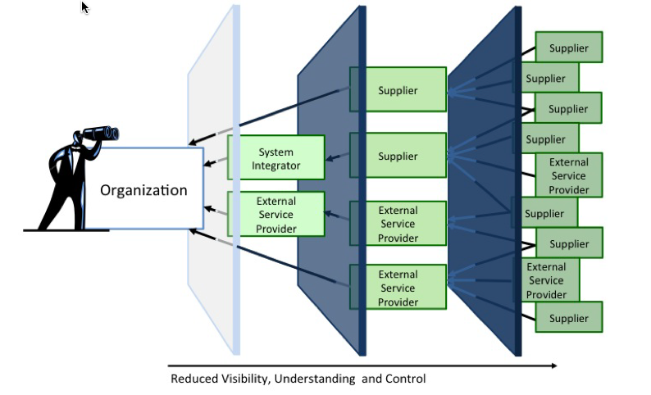
Supply Chain – Do you know where your data is going?
PROCESSES

Slide 16
Supply Chain - Risks and Mitigation Strategies
PROCESSES
Primary risk: Company data breach or loss within the Supply Chain
What are the issues? | What are you doing about it?
Releasing sensitive member information to 3rd party suppliers Limited control over the actions of supplier employees Supplier networks connected to company network 3rd Party suppliers performing more sensitive business processes both on and off shore | Contract Language On-Site Security Assessments Secure Room Requirements Background Investigations Registering Information Releases

Slide 17
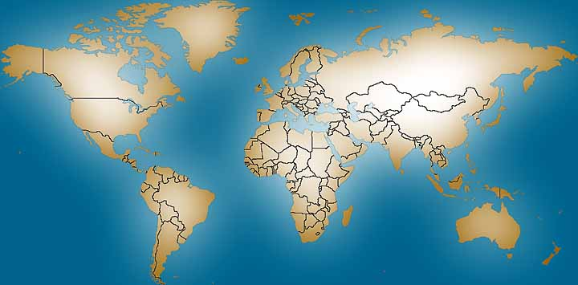
Supply Chain – An Example, Profile by Country
PROCESSES
X% of Company data access occurs at offshore locations
Canada – 20% of Offshore
11 Cities
38 Companies
989 workers have access
PII Volume: High
India – 50% of Offshore
10 cities
23 companies
1200 workers have access
PII Volume: High
Mexico – 5% of Offshore
4 Cities
8 Companies
550 workers have access
PII Volume: Low
Philippines – 5% of Offshore
5 Cities
5 companies
123 workers have access
PII Volume: Low
Other – 20% of Offshore
22 Countries
345 workers have access
* PII - Personally Identifiable Information

Slide 18
TECHNOLOGY

Slide 19
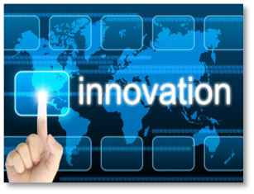
Innovation – Buying or building solutions
TECHNOLOGY
◆ Focus on innovation
19

Slide 20
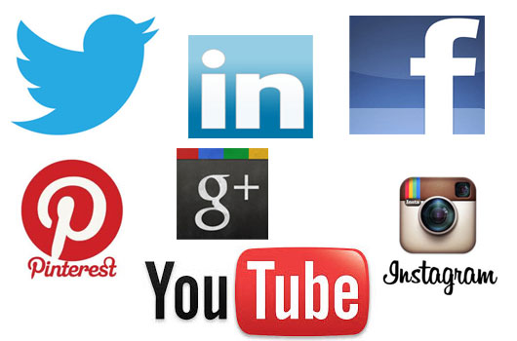
Innovation – Buying or building solutions
TECHNOLOGY
◆ Focus on innovation
◆ Social Media – Look for clues!
20

Slide 21
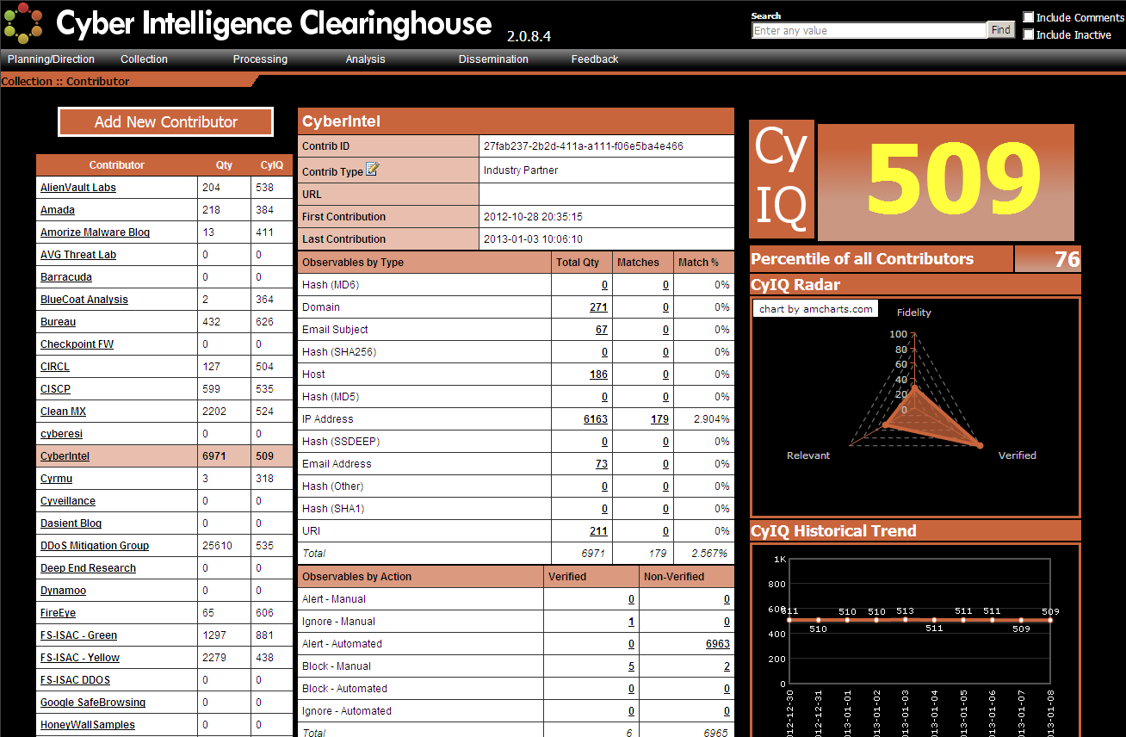
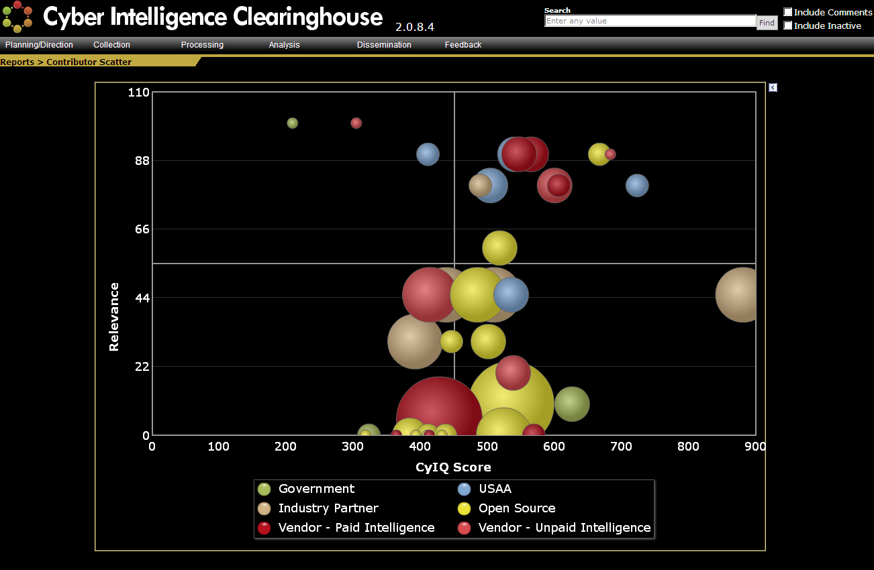
Innovation – Buying or building solutions
TECHNOLOGY
◆ Focus on innovation
◆ Social Media – Look for clues!
◆ Managing multiple data sources
21

Slide 22
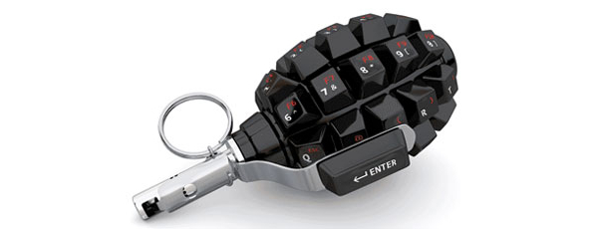
Cyber Kill Chain – One method to deal with APT, MALWARE
In military parlance, a “Kill Chain” is a phase-based model to describe the stages of an attack, which also helps inform ways to prevent such attacks. These stages are referred to as:
Find
Fix
Track
Target
Engage
Assess

Slide 23
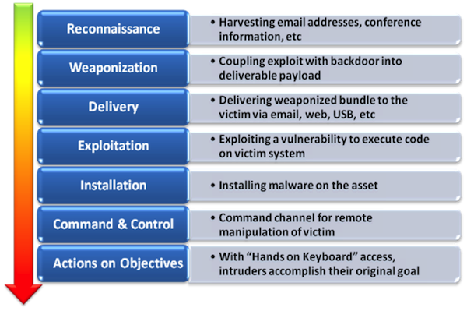
Cyber Kill Chain – Lockheed Martin

Slide 24
Weekly Cyber Kill Chain Metrics
- 94 events. Multiple Failed Logins and NIDS/NIPS alerts. All benign.
Reconnaissance
- 0 events.
Weaponization
- 39 events. Wireless IPS detections of Rogue Wireless Access Points. Benign.
Delivery
- 2 events. FireEye NX and CIC Match on PKI Domain. Resolved.
Exploitation
- 12 events. TripWire Events. Benign.
Installation
Command and Control
- 13 events. Blacklist DNS request for known malware domain. UPC Ultrabook removed from network.
- 58 events. Local user added to network device . Benign.
Actions on Objectives
Notes:
Slide updated 2014-07-14.
Definitions:
The Cyber Kill Chain is a framework developed by Lockheed Martin. It is based on military doctrine, and is a means to describe cyber attacks from the attacker’s perspective.

Slide 25
Layered Usage - Defense in Depth
TECHNOLOGY
Akamai DDoS, WAF
Email Security
IPS
XML Gateway
Vulnerability Mgt
Malware Prevention
Firewalls
Mobile Mgt
Imperva WAF
BlueCoat Proxy
Member
Authentication
Internal Fraud
Detection
Early Warning
Systems
RSA Transaction
Monitoring
FICO
SIEM
Perimeter Security
Financial Security
Enterprise Security
Data Security
Is this strategy sustainable in the future?
Large footprint to maintain
Difficult to manage
Requires extensive skill sets
Very $$$$$
Requires multiple niche solutions
Little economies of scale from large vendors
Identity and
Access Mgt
Palo Alto Firewalls
Anti-Virus
Certificate Mgt
SEIM
IPS
DB Firewall
Malware Prevention
DLP Solutions
Laptop Encryption
Big Data Security
Netwitness Secure
Analytics
Mandiant APT
Protection

Slide 26
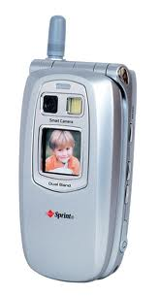
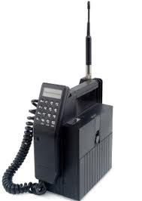
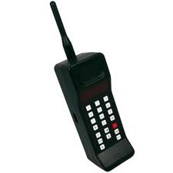
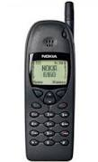
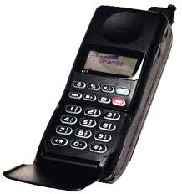
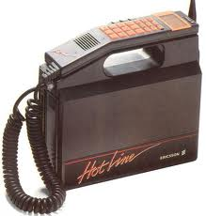
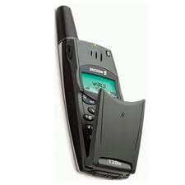
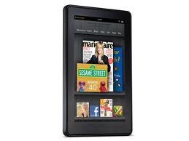
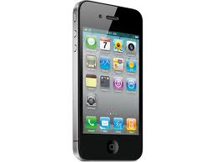
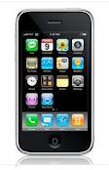
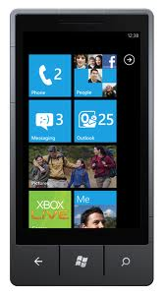
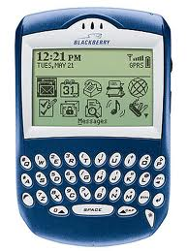
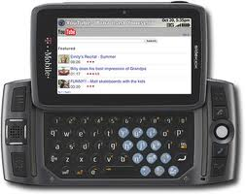
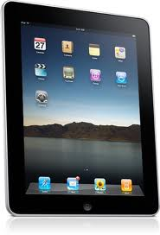
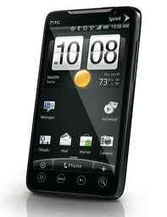
Evolution of Mobile Devices
TECHNOLOGY
70’s – 80’s
Analog Networks
Early 90’s
Digital Networks
97
First Camera Phone
2002
SideKick
2003
Blackberry
2007
iPhone 1

Slide 27
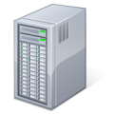
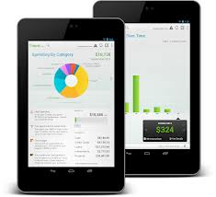
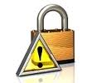
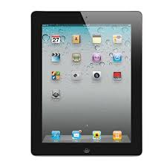
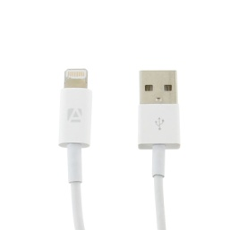
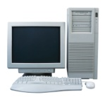
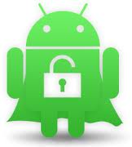
Mobile - The Changing Perimeter
TECHNOLOGY
GOOD NOC
Perimeter Controls
GOOD
Server
External data services
Business information
generated outside the
network.
Limited endpoint
Controls increase
risk of data leakage.
USB connectivity required for backup
and updates. Places untrusted content
Inside perimeter.
Sync to personally
owned devices.
Device Compromise (Jailbreak)

Slide 28
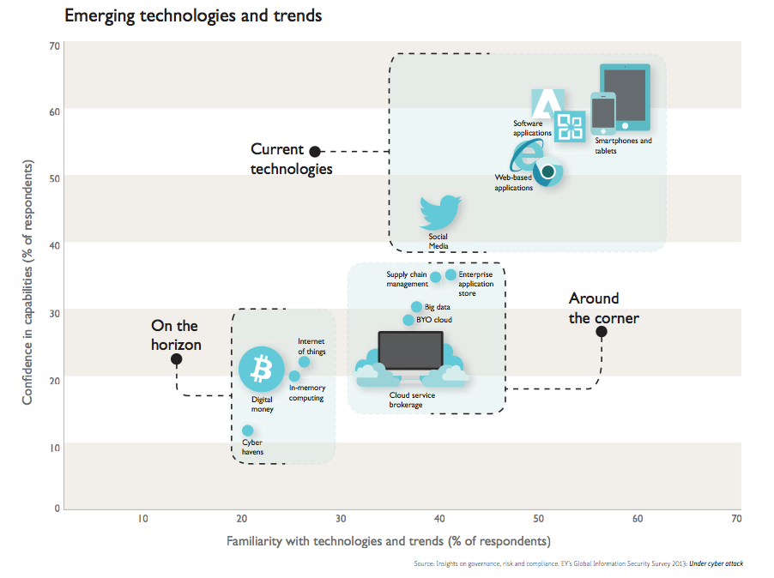
Emerging Technologies
TECHNOLOGY
◆ Mobile Wallet
◆ Biometric Authentication
◆ Cloud Computing
◆ Data Analytics
◆ Enterprise App Stores

Slide 29
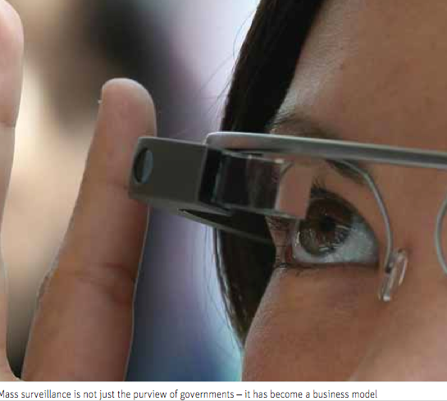
Just when you were finally falling a sleep…..
TECHNOLOGY
◆ Privacy Issues
◆ Data Loss Prevention
◆ Physical Security
◆ Legal/Compliance Issues

Slide 30
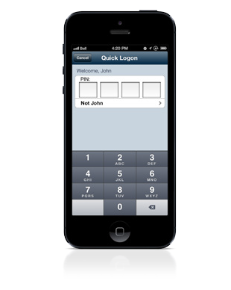
Examples of Best in Class Solutions - USAA
TECHNOLOGY
Quick/Secure Logon | My Security Advisor | Anti-Phishing | CyberCode
Online / Personal Security Partnerships | Device Registration | Password Strength Indicator | Security Center | My USAA Alerts

Slide 31
Final Thought
THE
DANGER
FOUND
IN COMPLACENCY
Notes:
There are no cyber security silver bullets…today’s cyber threats are too agile, too innovative and too well resourced. A strong security program as many characteristics but the most important element is ensuring a culture of non-complacency.

